Slide 1
Welcome
PC Training 2023

Slide 2
Module 1
Precinct Committeemen

Slide 3
So What is a PC?
“The Most Important Elected official to our Republican Party”
State Statute A.R.S. §16-822:
The duties of a precinct committeeman shall be to assist his political party in voter registration and to assist the voters of his political party to vote on election days.

Slide 4
Why be a Precinct Committeeman? (PC)
To change things, you have to change the laws
To change the laws, you have to change the people who make them
To be elected, your candidates have to be on the ballot

Slide 5
Why be a Precinct Committeeman? (PC)
To get on the November ballot you must win the primary
To win the Primary, you must get the support of people who make endorsements in the Primary, who:
Reliably vote in the Primary
Get out the vote of others in the Primary
These are the PCs!

Slide 6
The Mission Statement
To deliver the maximum number of Republican votes from your precinct
How do we do that?

Slide 7
PC Objectives – non Election Year
Precinct Committeeman build relationships in your Precinct with:
Republican voters
Independent voters
Fellow Precinct Committeemen
Get to know your precinct by surveying registered voters about their voting preferences, opinions, and important issues
Engaging in social activities with your neighbors: barbeques; book clubs; block parties; etc.

Slide 8
PC Objectives – non Election Year
Identify and register non-voters who may vote Republican
Identify low propensity registered Republican voters and influence them to vote
Increase Republican worker effectiveness
Invite your friends and neighbors to Republican events

Slide 9
PC Objectives – Election Year
Distribute campaign literature in your precinct
Walk door-to-door with candidates
Assist your local candidates with petition signature gathering, mailings, and phone calls
Hold events in your precinct for neighbors to meet candidates, such as coffee meetings
Help recruit volunteers to work with you in your precinct or work for local candidates

Slide 10
PC Objectives – Election Year
Inform voters of our positions on issues and candidates
Motivate voters to go to polls - give them reasons to vote for Republican candidates
Participate in meetings, special events, and fundraisers
Get our informed voters to the polls!

Slide 11
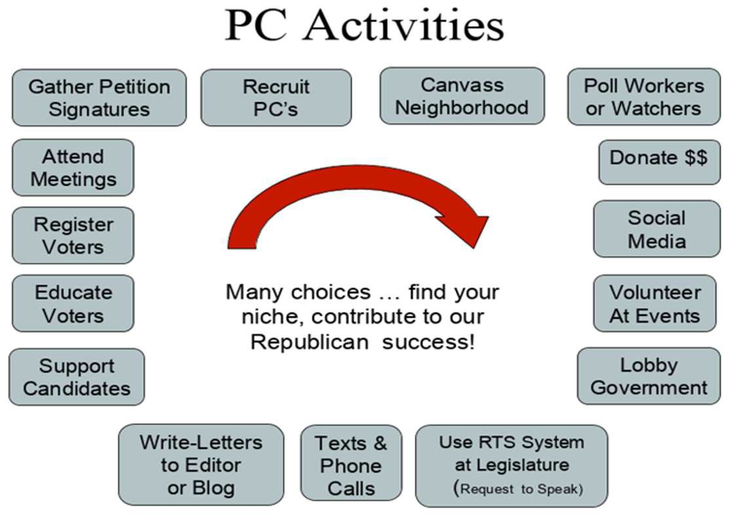
PC Activities
Different types of ways PCs can contribute to political work in their areas

Slide 12
Influence of the PC
Neighborhood Leader - friendly access to neighbors
Respect from elected officials
Your voice counts
You represent and influence many voters within your Precinct

Slide 13
Influence of the PC
Direct influence over policies, bylaws, resolutions and selection of candidates
Selection of candidates when elected officials resign or leave office before their term is over, (recent example in LD13)
Launching pad for other offices

Slide 14
Elected vs. Appointed Precinct Committeemen

Slide 15
Becoming an Elected PC
To run for election as a Republican PC a person must be:
A registered Republican
Reside in their precinct
PCs are elected at the Primary election in even numbered years

Slide 16
Becoming an Elected PC
Candidates for office must file following documents with County Elections Dept:
Nomination Petition signed by small number of voters registered in same party and residing in same precinct ( usually 10) Typically this begins in March and last approximately 30 days
A Nomination Paper Affidavit of Qualification will be provided around March. Every PC, whether previously elected or appointed must file again.
Term is two years - from October following the Primary to October following the next Primary

Slide 17
Advantages of Elected PCs
Must be an elected PC to run for legislative district, county or state Party leadership position
Elect Legislative District ( LD) leadership at organizational meeting (even numbered years)
Elect County Executive Board positions at Statutory Meeting (in odd numbered years)and at Mandatory Meeting (even numbered years) EXAMPLE: Chair, vs Member –at-large

Slide 18
Advantages of Elected PCs
Vote on Legislative District & County bylaws and resolutions
Vote on selection of candidates should there be a legislative vacancy ( Example LD13)
Eligible to run for State Committeeman
State Committeeman are Elected by your peers in your LD, who can vote for STATE Leadership

Slide 19
Appointed PCs
Registered Republicans can be appointed by the County Chairman to fill a vacancy where there is not an Elected PC
He or she must still register to run at the next primary election
Submit a PC application to the legislative district chairman
Approved by the District Chairman, County Chairman and County Board of Supervisors

Slide 20
Number of PCs per Precinct
Each precinct is allotted one PC just because it is a precinct
There are over 935 precincts in MARICOPA County
Then are allocated one additional PC slot for each 125 registered Republican voters in the precinct
Number of Voters in the Precinct as of March 1st of the general election year

Slide 21
Number of PCs per Precinct
Voter Registration Statistics – July 2023
Republican | 1,445,127 | 34.4%
Other -PND,IND | 1,450,697 | 34.6%
Democrat | 1,260,659 | 30.0%
Libertarian | 33,738 | 0.8%
No Label | 8505 | 0.2%
Total | 4,198,726 | 100%
SO WHERE DO PCs FIT INTO THE PARTY?

Slide 22
How important is a PC?
- 12,000 Vote Difference
10 Votes/Precinct
2 Votes/PC
How could this have changed the outcome?

Slide 23
Module 2
Party Structure

Slide 25
Internal Party Elections
PCs are elected every two years during the Primary by the voters of their party in their precinct
Elected PCs elect their legislative District leadership team (LD Board) and State Committeemen to represent their legislative district

Slide 26
Internal Party Elections
PCs elect 1 State Committeeman for every 3 elected PCs in their Legislative District (LD)
State Committeemen elect State Leadership in January at:
Statutory Meeting (odd years: 2023)
Mandatory Meeting (even years: 2024)

Slide 27
State Committeeman
Governing body of the State Party
Must be an elected PC to be a State Committeeman
State Committeemen are elected at the County or Legislative District (Maricopa and Pima) organizational meetings within their Districts

Slide 28
State Committeeman
Legislative Districts are allotted 1 State Committeeman for every 3 elected PCs.
Elect State Executive Committee
Elect 3 Members-At-Large from each of the State’s Congressional Districts
Vote on State bylaws and resolutions

Slide 29
Election of the State Committee
Biennial Statutory meeting (odd-numbered years)
All Elected State Committeemen attend
Elections held for the State Chairman, Secretary, and Treasurer
Elections held for 3 Members-At-Large from each of the State’s Congressional Districts

Slide 30
Election of the State Committee
Biennial Mandatory meeting (even-numbered years
All Elected State Committeemen attend
Elections held for the State Party's 1st, 2nd, and 3rd Vice Chairmen, Assistant Secretary, Assistant Treasurer, Sergeant-at-Arms and Assistant
Sergeant-at-Arms
Vote on Bylaw changes and resolutions

Slide 31
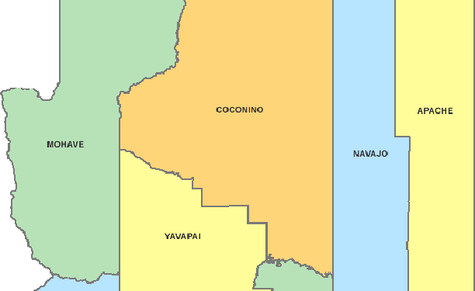
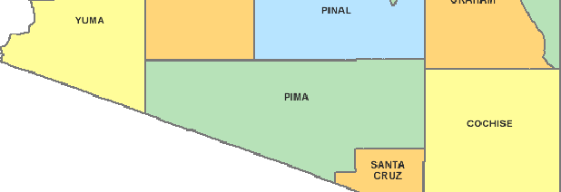
Arizona is divided into 15 Counties

Slide 32
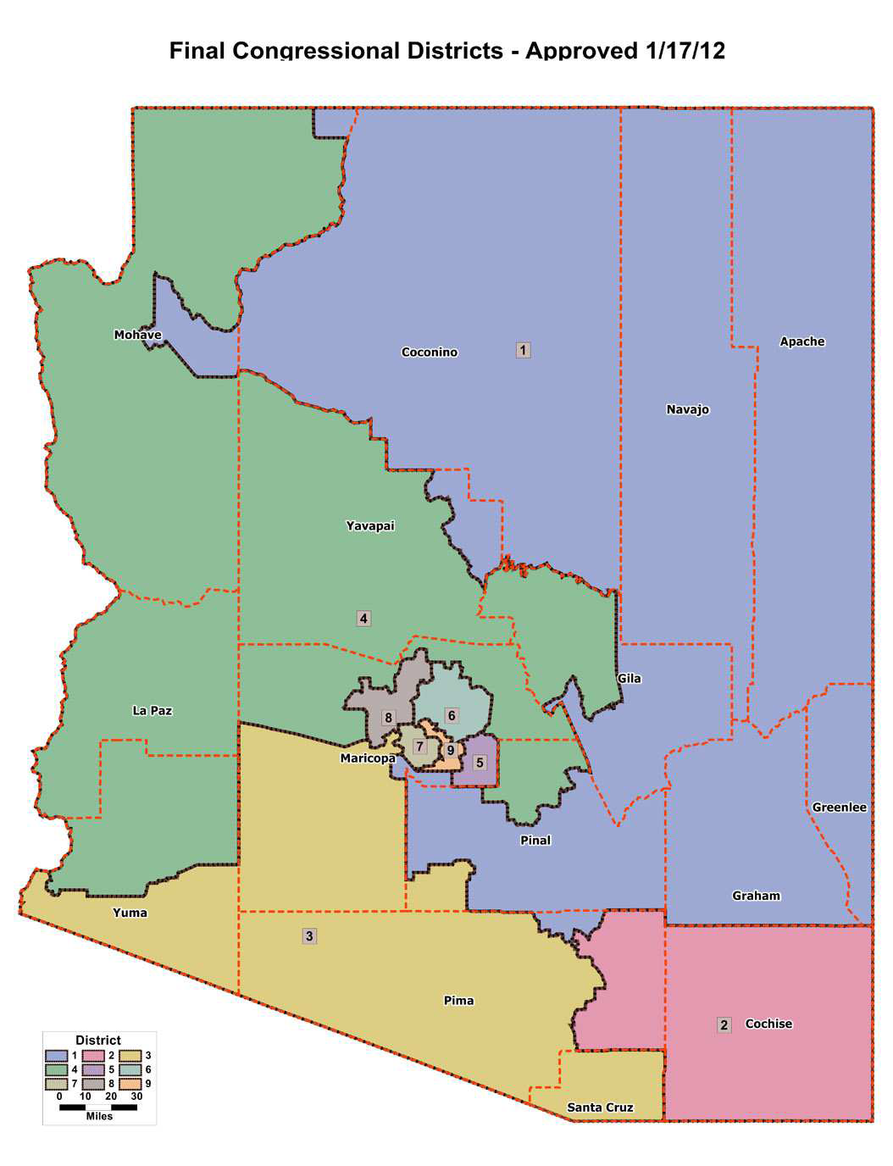
Arizona is Divided into
9 Congressional Districts

Slide 33
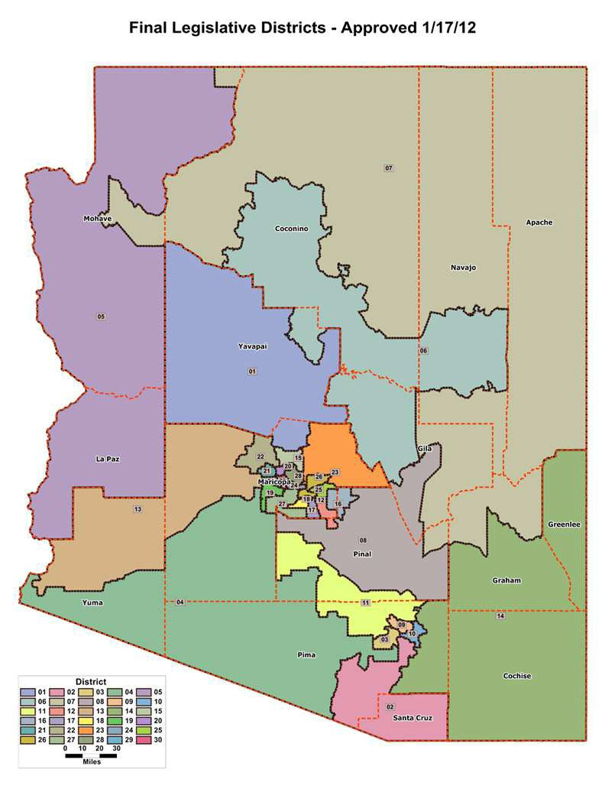
Arizona is divided into 30 Legislative Districts

Slide 34
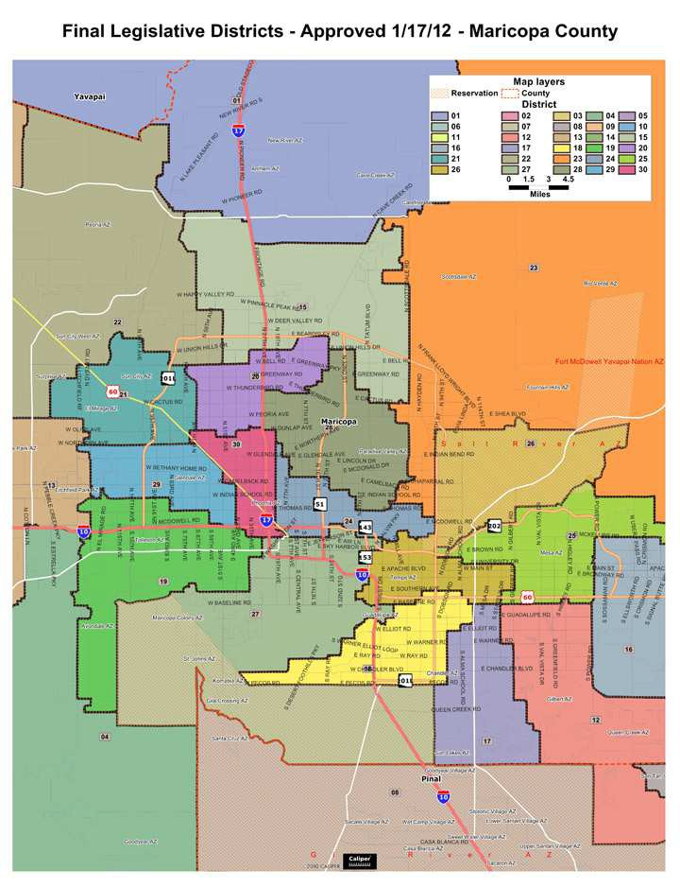
22 of the 30 Legislative Districts are in Maricopa County

Slide 35
Executive Guidance Committee (EGC)
An EGC is formed for counties with populations of 500,000 or more persons
The EGC sets the direction of the County party, links to State party, hosts county-wide events, aids in recruitment of PCs, GOTV and more.

Slide 36
Executive Guidance Committee (EGC)
Chairman
1st Vice Chair
2nd Vice Chair
Secretary
Treasurer
20 Legislative District Chairman
Precinct Committeemen (non-voting)
5 Members at Large
*This example is based on Maricopa County additional counties may differ slightly in their positions

Slide 37
What makes a legislative district?
The legislative district lines are drawn by appointees of the State.
In AZ, each county of less that 500,000 population is a legislative district.
In counties with a population of 500,000 or more, lines are drawn dividing the county into legislative districts
Notes:
935 Precincts. 8,197 Republican PC slots. Only 3,180, IIRC, were elected in 2022. That was only 38.8%. And little progress has been made. We haven't even filled 50% yet. About two-thirds of the Republican slots in Arizona are STILL vacant.

Slide 38
What makes a district?
Each AZ Legislative District has 3 state representatives, 2 serve in the house and 1 in the Senate.
Each legislative district also includes various city council and school boards.

Slide 39
Legislative Districts
Chairman
1st Vice Chair 2nd Vice Chair
Some districts have
these additional positions ➔
Treasurer
Secretary
3rd Vice Chairs
4th Vice Chairs
or
Corresponding Secretary
PC Captains
Precinct Committeemen
Area Leaders

Slide 40
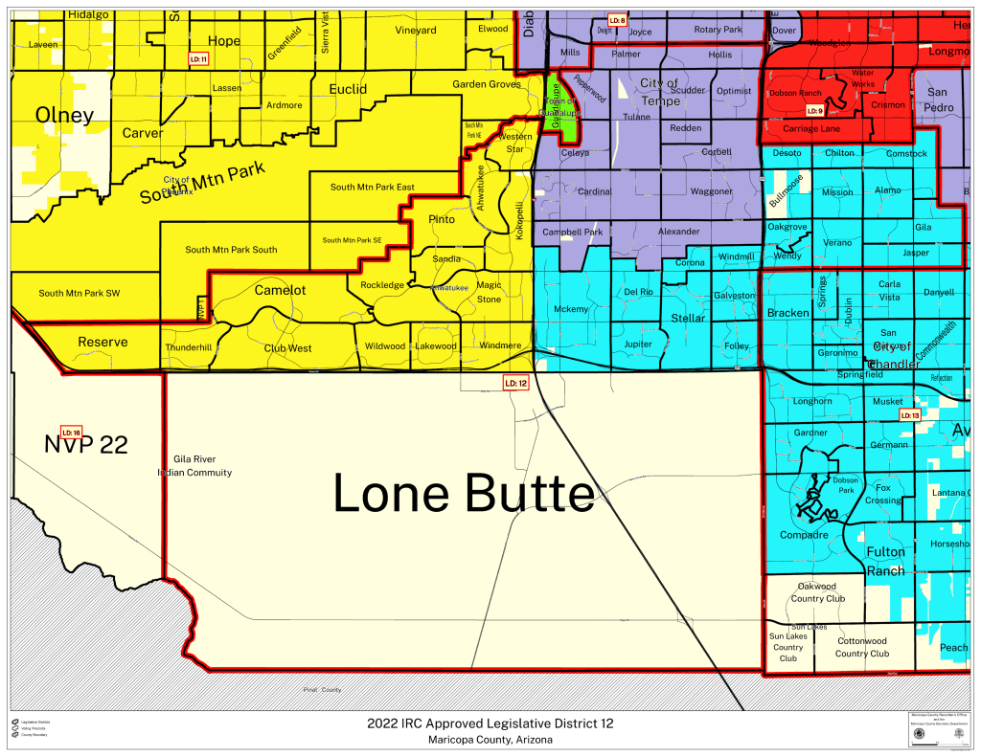
Legislative District 12: 49 Precincts - 282 PC’s

Slide 41
What is a Precinct?
A geographical area of residents drawn to enable all registered voters to vote at one location in one day.
It is your immediate political community and you are the elected representative of the GOP in that community.
Total of 1,495 PLUS precincts in Arizona

Slide 42
What is a Precinct?
Boundaries drawn by County Recorders’ offices
As area’s population grows, precincts are usually split into new smaller ones
Redistricting in 2012 - precincts were actually consolidated to help reduce the number of polling locations
The number of precincts reduced from 1142 to 724 in Maricopa County
THIS WAS NOT A GOOD THING!

Slide 43
Module 3
Connecting With Your Voters

Slide 44
PC Duties
ATTEND Precinct, Legislative District, and County meetings
EDUCATE inform neighbors, become the ‘go to person’ on political issues and "how should I vote" questions
REGISTER Republicans to vote
ELECT a Captain who is willing to donate time, energy, and leadership to the precinct
CANVASS your precinct periodically and keep track of changes in the neighborhood, making sure all Republicans are registered to vote

Slide 45
PC Duties
RECRUIT additional PCs, precinct volunteers and assign specific blocks to them for door-to- door and telephone work
ACTIVELY SUPPORT party activities at all levels
CARRY nominating petitions, distribute election information and candidate literature in your precinct
PARTICIPATE in GOTV (Get Out The Vote) and Election Day activities by helping at the polls
HOLD your elected officials accountable to their campaign promises.

Slide 46
Walking Door to Door
Once you have downloaded the Campaign Sidekick Walk App, you can start walking your Precinct.
Here are some helpful tips:

Slide 47
Walking Door to Door
Always walk with a partner
Wear a name badge
Introduce yourself. Remember: you are an elected official of the party, YOU are their Precinct Committeeman!
Ask them about their concerns. Then listen
Do they seem interested?

Slide 48
Walking Door to Door
Do they need to get on the PEVL (permanent early voter list for early ballots)?
Know how many PCs are in your precinct and how many are needed. This is a time for possibly recruiting PCs
Invite them to your legislative district meeting
Stay in contact with them. Ask for their email address

Slide 49
Walking Door to Door
Fill out the app’s surveys (we can customize them as well)
ALWAYS leave something with them - that includes your contact information.
Have them fill out a PC Application.
Carry a candidate or issue petition.

Slide 50
What to take with you
Business Card / Nametag / Pen / Walking list
Voter Registration Forms (PEVL/Early Ballot)
Candidate literature / Petitions
PC Applications / Your Legislative District information
Surveys

Slide 51
Module 4
Resources

Slide 52
Now What?
To become a successful PC, you must have knowledge that you can share with the voters in your community!
You should be the Go-To person for the voters in your precinct when they have a question
The following are resources that can help you be successful:
Your Legislative District Chairman and leadership team to include Area Directors
Always contact them first when you have questions or concerns

Slide 53
Voter Data
The State Party gets monthly updates on the voter data and all PCs have access to it
Contact your Legislative District Chairman to get access to the Voter Data or set up training
The access forms are also in the attachment file of the class with info on where to submit it

Slide 54
VOTER SPECTRUM
WEB BASED, (NOT AN APP),FOR YOUR PHONE OR COMPUTER/LAPTOP
YOU CAN OBTAIN WALKLISTS ON THE WEB
YOU CAN OBTAIN WALKLIST AND WALK MAPS FOR YOUR CELL PHONE WHILE ON THE WEB.
DO NOT NEED AN APP TO DO THIS!,
Voterspectrum.com

Slide 55
Maps
Depending on which county you live in maps of your precinct/legislative district will be located at different locations.
Contact your LD or County Chairman for assistance
If you are in Maricopa County you can obtain maps online at www.recorder.maricopa.gov/electionmaps

Slide 56
Maps
You can also obtain maps in person for a small fee at:
Maricopa Elections and Recorders 111 S. Third Ave.
Phoenix AZ 85003
Hours: 8am-5pm / Monday-Friday Phone: 602.506.3535
T.D.D. 602.506.2348

Slide 57
PC Handbook
A copy of the State Party PC Handbook is located in the attachment file. It contains:
The purpose and influence of the PC
Ways to connect with the voters
The importance of voter registration
What does it take to qualify to vote?
Party Structure
Contact info for all elected officials
The Republican Party Message and Principles
R vs. D… Is there a difference?
Republican Party History
And much more.

Slide 58
Social Media
The State Party along with each legislative district and county should have their own:
Website
Social media accounts
a "SoComm" (social media) team
These are great tools to share with those in your precinct so that they can follow your legislative district and county and keep up to date on events and news.

